Slide 1
Impact Bonds focus on improving impact
Impact bonds incentivise the achievement of impact through linking funding to results and provide the corresponding implementation flexibility required to achieve impact:
TRADITIONAL AID MODEL
IMPACT BOND MODEL
Donor subject to public accountability, but program implemented
by third party
Government / Donor pays for impact achieved, rather than controlling inputs and processes
Program may achieve lower than expected impact as cannot adapt to local circumstances and real-time data
Donor often focuses on financing inputs and processes to control what and how impact
is achieved
Impact achieved improves as program is adaptive, client-centred and evidence-based
Up-front capital from investors to service providers and provision of real-time performance management

Slide 2
Impact bonds build on best practice
Social Impact Bonds for key and vulnerable populations intend to expand on existing proven approaches, while ensuring that the model upholds human rights of these populations:
This can be achieved through:
Clear Boundaries: A programme framework that sets clear boundaries for goals and methods
Outcome selection: Careful selection of outputs to avoid incentives for undesirable data collection methods or pressures
Intervention analysis: Explicit criteria for what interventions and data collection methods are permissible, and which are not
Selected Investors: Investors restricted to those with a strong commitment to social goals and human rights
Innovative financing mechanisms such as social impact bonds go hand-in-hand with government funding for key populations, and should supplement their efforts in being more effective.
The ambition is that impact bonds will pave the way for larger-scale – and more cost-effective and sustainable – Government implementation of proven interventions.
Notes:
Investors’ focus on outcomes rather than inputs creates a strong incentive for adaptive implementation of services

Slide 3
Key characteristics of impact Bonds
Impact Bonds aim to improve the efficiency and effectiveness of development programmes through shifting payments - and thus accountability - to outcomes instead of inputs. The focus on outcomes allows and encourages local adaptation according to the specific and changing needs of service users.
Incentives for adaptive implementation
Linking investor returns to desired outputs and outcomes creates a strong incentive for adaptive implementation of programmes to achieve better services for beneficiaries
Enhances transparency and accountability
Investors are only compensated when contract outcomes and outputs have been independently verified
Outcomes funder only pays for success
As with other Results-Based Aid, outcomes funders (government / donors) only pay for if agreed outcomes are met
Provide access to upfront funding
Upfront funding provides working capital to service providers and risk is transferred to private investors
Notes:
Investors’ focus on outcomes rather than inputs creates a strong incentive for adaptive implementation of services

Slide 4
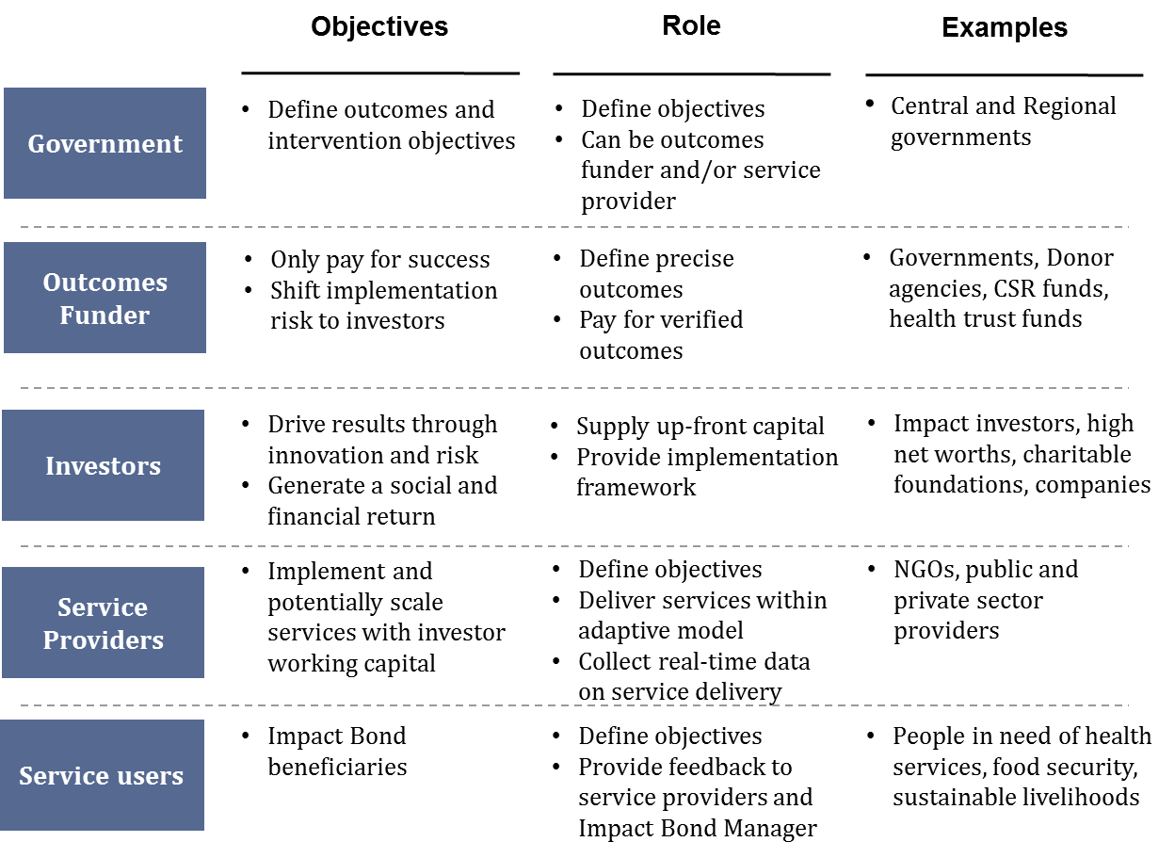
Objectives and roles of key parties

Slide 5
Principles for a successful Impact Bond
For an Impact Bond to be successful it must:
Add value: Potential exists to improve outcomes through transfer of risks to investors
Be feasible: Improvement in outcomes measurable and stakeholder buy-in
PRINCIPLES | Rationale
Need for outcomes focus | Demonstrated need for increased focus on outcomes in target geography and coordination of key stakeholders to achieve outcomes
Promising interventions | Focus on expanding intervention with some evidence-base to ensure attractiveness to investors, but also uncertainties to justify risk transfer
Service providers require working capital | Service providers do not have sufficient upfront funding to pay for interventions or cannot bear the implementation risk alone
Good potential for attribution of outcomes | Target population and outcome metrics can be clearly defined and agreed upon Data for outcome metrics and benchmark can be collected in a reliable and cost-effective way and used to disaggregate the impact of the interventions
Priority for donors and partner governments | Potential donor agency and partner governments have interest in payment-by-results approaches and regard target outcomes as high priority
Viable investment proposition | Issue area / geography a priority for potential investors Reasonable level of evidence around effective intervention approaches
Add value
Feasibility

Slide 6
Impact development involves three main phases
PHASE 1
High level scoping
PHASE II
Detailed design
PHASE III
Capital Raise
SIB IMPLEMENTATION
Phase I: High level scoping and stakeholder engagement (typically: 6-8 weeks)
Stakeholder engagement e.g. impact bond approach tested with service beneficiaries and providers, government and other key stakeholders for suitability to the issue area and country context
Feasibility analysis e.g. early exploration of the ability of government / donors to fund outcomes, contracting environment, capacity of potential partners to implement services via an impact bond and potential to measure and track outcomes
Phase II: Detailed design and securing of funding for outcomes (typically: 6 months)
Detailed impact bond design work conducted in partnership with key stakeholders – focused around:
Outputs and outcomes metrics, measurement and verification
Intervention model i.e. service design
Outcomes funding, contracting and governance
Data collection and performance management
Budget, operational and financial modelling
Investor soft marketing
Phase III: Formal investor marketing, capital raise and service mobilisation (typically: 3-6 months)
Once commitment to fund outcomes has been agreed with government / donors, funding is raised from socially motivated private sector investors to fund interventions under an impact bond structure – if and only if outcomes are successfully verified, outcomes payments from government / donors are triggered to repay investors their capital plus a return linked to the level of success and the level of risk taken

Slide 7
Thanks for listening!!

